Slide 1

Social Media Analytics via Graph Visualization
Artiﬁcial Intelligence
Supervised by Dr. Sabah Mohammed
Submitted by:
Chovatiya, Jay Maheshbhai (1161980)
Ghori, Rutvikkumar Rameshbhai (1190463)
Iqbal, Muhammad Zahid (1190014)
Jariwala, Siddhi Kalpesh (1194116)
Patel, Dhruv (1188351)

Slide 2
Introduction
The emergence of Online Social Networks (OSN) has been a catalyst for the Big Data era.
Analyzing this data requires the integration of scientific tools and expertise across various disciplines, including social network analysis, sentiment analysis, trend analysis, and collaborative recommendation.
Recent emergence of these tools and the complexity of processing human-generated data, there is a need for a comprehensive and updated taxonomy of social data networking analysis frameworks.

Slide 3
Introduction
Our aim here is to provide a sophisticated classification of current state-of-the-art frameworks, taking into account the diversity of practices, methods, and techniques.
We enlighten the challenges and future directions, with a particular focus on text mining and the promising avenue of computational intelligence.
Social networks are very well-liked because they make it easy to meet new people, are great for finding jobs, and assist businesses in reaching out to prospective clients.

Slide 4
Introduction
Although IS (information systems) researchers have shown that social media analytics can be helpful in several phases of a crisis, many EMAs (emergency management agencies) have not yet grasped the potential of using social media for crisis management. (Ahmed, 2011; Houston et al., 2015). Previous research has demonstrated that social media analytics can identify a problem before it is publicly reported. (Cameron et al., 2012; Crooks et al., 2013). EMAs could respond to crises more quickly and dispatch aid sooner if they used social media analytics. At least some EMAs are already using existing data gathering techniques and even social media analytics tools (Ludwig et al., 2015b). The American Red Cross, for instance, makes use of social media.

Slide 5
Discussion
Social media analytics via graph visualization has its critics who argue that it is not a reliable way to make informed decisions. According to these critics, graph visualization oversimplifies complex data, which leads to inaccurate conclusions. Moreover, they argue that graph visualization cannot capture the subtleties of human behavior, making it ineffective in predicting future trends.
There is some evidence to support the idea that graph visualization can be misleading. A study conducted by researchers at the University of Texas at Austin found that graph visualization can lead to biased conclusions, especially when the graph is too complex. The study also revealed that graph visualization can obscure important data points, leading to inaccurate interpretations. This means that relying solely on graph visualization can result in oversimplification, leading to an incorrect understanding of the data.

Slide 6
Discussion
Moreover, critics argue that social media analytics via graph visualization cannot account for the nuances of human behavior. A study published in the journal Information Systems Research found that social media data is often incomplete and unreliable, making it difficult to draw meaningful conclusions.
Additionally, critics argue that graph visualization cannot capture the complex relationships between individuals and groups, making it ineffective in predicting future trends. This means that social media data may not be representative of actual human behavior, leading to inaccurate predictions.

Slide 7
Discussion
Moreover, while it is true that social media data can be incomplete and unreliable, this does not mean that it is useless. By using advanced algorithms and machine learning techniques, analysts can filter out irrelevant data and identify meaningful patterns in the data.
For example, sentiment analysis can be used to determine the overall mood of a social media conversation. Additionally, social media analytics via graph visualization can be combined with other sources of data, such as surveys and focus groups, to provide a more complete picture of consumer behavior.

Slide 8
Opinion:- Graph visualization provides a comprehensive and clear view of user behavior on social media plat-forms
Support:-
A report by Gartner states that graph analytics can help in identifying fraud, detecting network intrusions, and providing insight into customer behavior.
A case study by Amazon Web Services shows how graph visualization helped in analyzing user behavior on their e-commerce platform, resulting in improved recommendations and increased customer engagement.
Graph visualization can be used to detect and prevent social media abuse and harassment.

Slide 9
Opinion:- Graph visualization can help in identifying and tracking abusive behavior on social media platforms, thereby enabling timely intervention and prevention
Support:-
A study by the University of Cambridge found that graph analysis could help in detecting abusive behavior on social media platforms. The study used graph visualization to analyze the connections between users, identifying patterns of abusive behavior.
Facebook uses graph analysis to detect and prevent fake accounts and spam. The company also uses graph visualization to identify patterns of abusive behavior, such as hate speech and harassment.
The Anti-Defamation League (ADL) uses graph analysis to track and monitor hate speech and extremist behavior on social media platforms.

Slide 10
Opinion:- Graph visualization can provide insights into user behavior that can be used to improve social media marketing strategies
Support:-
A study by McKinsey found that companies that use analytics and data visualization in their marketing strategies are more likely to achieve their marketing objectives.
Graph visualization can help in identifying user behavior patterns that can be used to improve the relevance and targeting of social media advertising.
A case study by Twitter shows how graph visualization helped in identifying and targeting key influencers on the platform, resulting in improved engagement and increased reach.

Slide 11
Dataset
In this research paper, Netflix TV Shows and Movies (2022 Updated) are used. This dataset can be found on Kaggle. Here, whole dataset is here.
https://www.kaggle.com/datasets/thedevastator/the-ultimate-netflix-tv-shows-and-movies-dataset
Multiple csv files of Netflix movies and shows are included in this dataset. Best television shows and Best Movies files have seven characteristics, including the title, primary production, and release year. In this code, a graph illustrating their connection is presented.
Whole code can be found on below link.
https://github.com/technicalrutvik/Social_Network_Analysis/blob/main/Position_Paper_AI.ipynb

Slide 12
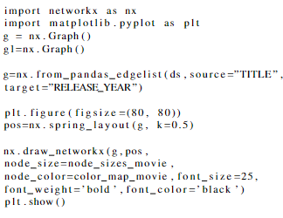
Graph Visualization in Python
To visualize graph using this dataset, NetworkX python library is used.
Here, the most common code to make graph of them.

Slide 13
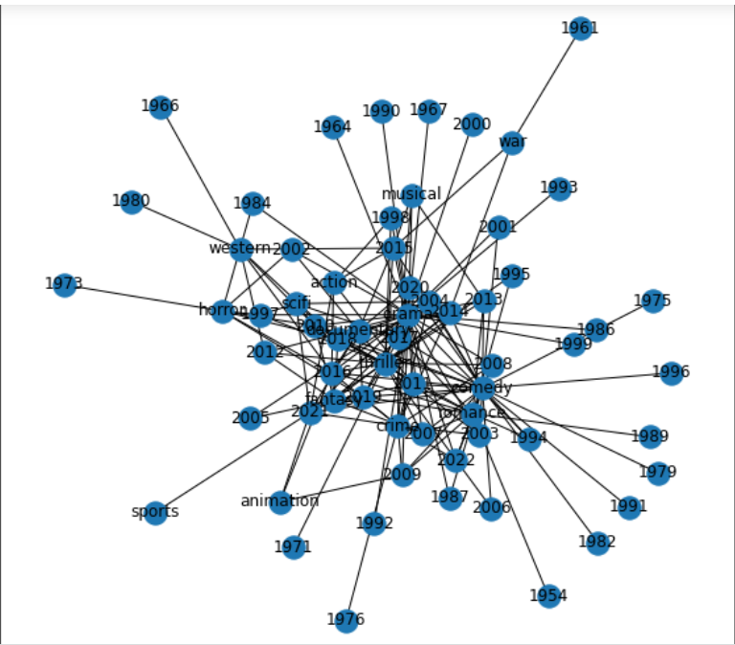
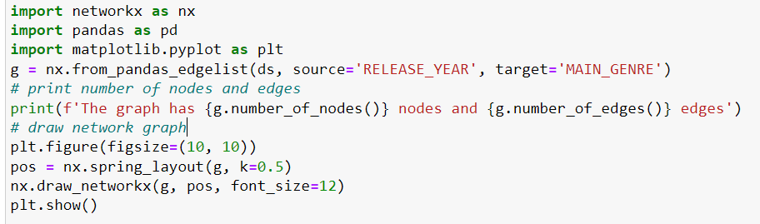
Graph Visualization in Python
Code:-
The graph has 64 nodes and 165 edges

Slide 14
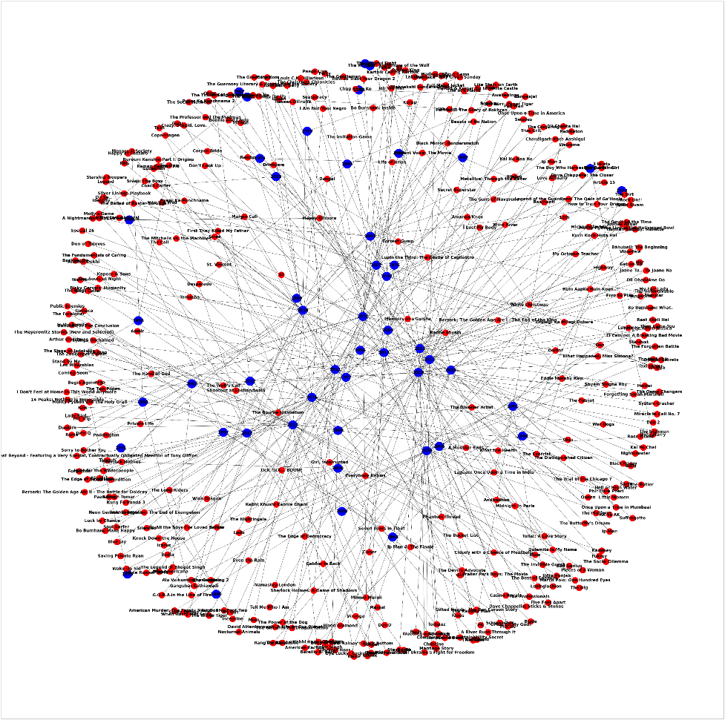
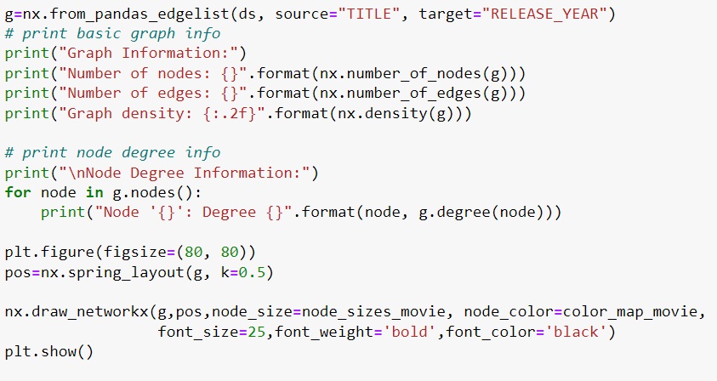
Graph Visualization in Python
Number of nodes: 436 Number of edges: 387

Slide 15
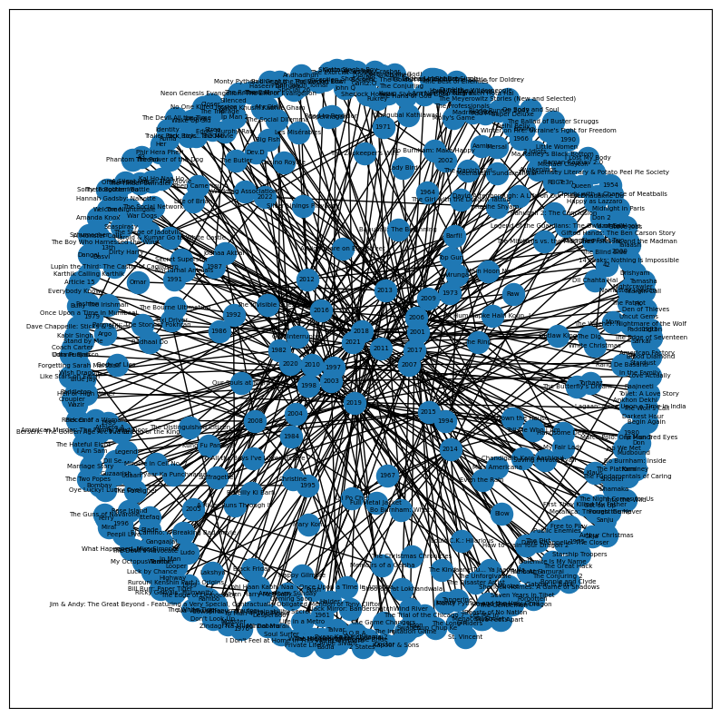
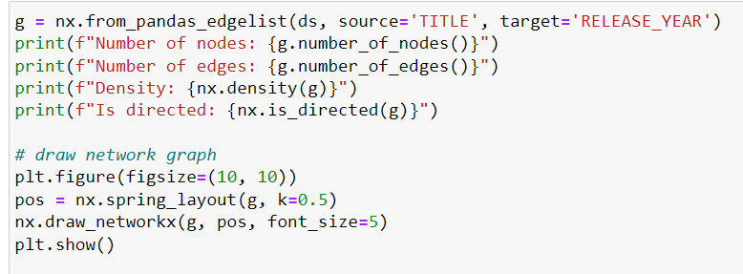
Graph Visualization in Python
Number of nodes: 436, Number of edges: 387 , Density: 0.004080987029421069

Slide 16
Conclusion
social media analytics via graph visualization is a valuable AI/ML technology that can provide valuable insights for businesses and individuals.
By analyzing the relationships and connections between users and their activity on social media platforms, this technology can help identify trends, sentiment, and influencers in a particular market or community.
Graph visualization allows for a more intuitive and interactive representation of data, enabling users to explore and identify patterns and insights more easily.
This technology is particularly useful for businesses looking to optimize their marketing strategies, as it can help identify key influencers and target demographics.
When considering whether to use social media analytics via graph visualization, it is important to first assess the specific needs and goals of your business or organization. This will help determine which social media platforms to analyze and what data to collect.

Slide 17
Future Works
While graph visualization is a powerful method for visualizing social media data, one can also experiment with other visualization techniques. Heat maps and network graphs, for example, can be used to emphasize patterns and trends in social media data. Utilize user behavior analysis: one can analyze user behavior such as liking, commenting, and sharing in addition to the substance of social media posts. This allows you to obtain insights into user engagement and apply this knowledge to our social media marketing plan.
Social media is a fluid medium, and patterns can shift quickly. To keep up with the latest trends, create a real-time monitoring system that monitors social media activity and updates your analysis as needed

Slide 18
References
[1] I. Lee, “Social media analytics for enterprises: Typology, methods, and processes,” Business Horizons, vol. 61, 11 2017.
[2] S. Stieglitz, M. Mirbabaie, J. Fromm, and S. Melzer, “The adoption of social media analytics for crisis management - challenges and opportunities,” 06 2018.
[3] D. Goldenberg, “Social Network Analysis: From Graph Theory to Applications with Python,” arXiv e-prints, p. arXiv:2102.10014, Feb. 2021.

Slide 19
Thank You

